Slide 1
Graphs

Slide 2




Graphs
Graphs are very useful structures in Computer Science
They have all sorts of applications:
  Scheduling
  Optimization
  Communication

Slide 3

Graphs
Def: A graph 𝐺 is a pair of sets (𝑉,𝐸) where:
𝑉 is a nonempty set of items called vertices (or nodes)
𝐸 is a set of 2-item subsets of 𝑉 called edges
𝑣₂
𝐺 = (𝑉, 𝐸)
𝑣₄
𝑉 = {𝑣₁, 𝑣₂, 𝑣₃, 𝑣₄, 𝑣₅, 𝑣₆, 𝑣₇, 𝑣₈}
𝑣₁
𝑣₆
𝑣₇
𝑣
8
𝐸 = { 𝑣₁, 𝑣₂ , 𝑣₁, 𝑣₃ , 𝑣₂, 𝑣₄ ,
𝑣₃, 𝑣₄ , 𝑣₃, 𝑣₅ , 𝑣₅, 𝑣₆ ,
𝑣₅, 𝑣₇ }
𝑣₅
Edges also represented by:
𝑣₁ − 𝑣₂
𝑣₃
23

Slide 4
Graphs
Def: A graph 𝐺 is a pair of sets (𝑉,𝐸) where:
𝑉 is a nonempty set of items called vertices (or nodes)
𝐸 is a set of 2-item subsets of 𝑉 called edges
A graph doesn’t need to have any edges
𝑣₂
𝑣₄
𝐺 = (𝑉, 𝐸)
𝑣₁
𝑣₆
𝑣₇
𝑣
8
𝑉 = {𝑣₁, 𝑣₂, 𝑣₃, 𝑣₄, 𝑣₅, 𝑣₆, 𝑣₇, 𝑣₈}
𝐸 = ∅
𝑣₅
𝑣₃

Slide 5
Graphs Terminology
Adjacent: Two nodes 𝑣_{𝑖} and 𝑣_{𝑗} are adjacent if they are connected by an edge ( 𝑣_{𝑖}, 𝑣_{𝑗} ∈ 𝐸)
𝑣₂
𝑣₅ is adjacent to 𝑣₇
𝑣₄
𝑣₁
𝑣₆
𝑣₇
𝑣₅ is not adjacent to 𝑣₄
𝑣₈
𝑣₅
𝑣₃

Slide 6
Graphs Terminology
Adjacent: Two nodes 𝑣_{𝑖} and 𝑣_{𝑗} are adjacent if they are connected by an edge ( 𝑣_{𝑖}, 𝑣_{𝑗} ∈ 𝐸)
Incident: An edge 𝑒 = {𝑣_{𝑖}, 𝑣_{𝑗}} is incident to 𝑣_{𝑖} and 𝑣_{𝑗}
𝑣₂
𝑣₄
𝑣₁
𝑣₆
𝑣₇
𝑒 is incident to 𝑣₁ and 𝑣₃
𝑣
8
𝑒
𝑣₅
𝑣₃

Slide 7
Graphs Terminology
Adjacent: Two nodes 𝑣_{𝑖} and 𝑣_{𝑗} are adjacent if they are connected by an edge ( 𝑣_{𝑖}, 𝑣_{𝑗} ∈ 𝐸)
Incident: An edge 𝑒 = {𝑣_{𝑖}, 𝑣_{𝑗}} is incident to 𝑣_{𝑖} and 𝑣_{𝑗}
Isolated: A vertex is isolated if there are no edges connecting the vertex
𝑣₂
𝑣₄
𝑣₁
𝑣₆
𝑣₇
𝑣₈ is isolated
𝑣₈
𝑣₅
𝑣₃

Slide 8
Graphs Terminology
Degree of a vertex: The number of edges incident to a vertex
𝑣₂
Deg(𝑣₂) = | 2
Deg(𝑣₅) = | 3
Deg(𝑣₇) = | 1
Deg(𝑣₈) = | 0
𝑣₄
𝑣₁
𝑣
6
𝑣₇
𝑣₈
𝑣₅
𝑣₃

Slide 9
Graphs Terminology
Degree of a vertex: The number of edges incident to a vertex
Simple Graph: Undirected graph with no loop or multiple edges
Loop: Edge that only connects one vertex
Multiple edges: Two edges that connect the same vertexes
𝑣₂ 𝑣₃
𝑣₁

Slide 10
Graphs Terminology
Directed Graph (digraphs): Consists of a nonempty set of vertices 𝑉 and a set of directed edges 𝐸.
  Each directed edge is associated with an ordered pair of vertices.
  The directed edge associated with the ordered pair (𝑢, 𝑣) is said to start at 𝑢 and end at 𝑣.
𝑢
𝑣
𝑒
𝑡𝑎𝑖𝑙
ℎ𝑒𝑎𝑑
The edge 𝑒 starts at the tail of 𝑢 and ends at the head of 𝑣.

Slide 11






Graphs Terminology
Directed Graph (digraphs): Consists of a nonempty set of vertices 𝑉 and a set of directed edges 𝐸.
  Each directed edge is associated with an ordered pair of vertices.
  The directed edge associated with the ordered pair (𝑢, 𝑣) is said to start at 𝑢 and end at 𝑣.
  𝑢 is adjacent to 𝑣 and 𝑣 is adjacent from 𝑢
  In-degree of a vertex: # of edges with 𝑣 as terminal vertex.
  Out-degree of a vertex: # of edges with 𝑣 as initial vertex.
𝑣₂
In-Deg(𝑣₂) = | 1
Out-Deg(𝑣₂) = | 1
In-Deg(𝑣₃) = | 0
Out-Deg(𝑣₃) = | 3
𝑣
4
𝑣₁
𝑣₆
𝑣₇
𝑣₈
𝑣₃
𝑣₅
32

Slide 12
Graphs Terminology
Directed Graph (digraphs): Consists of a nonempty set of vertices 𝑉 and a set of directed edges 𝐸.
𝑣₂
𝑉 = {𝑣₁, 𝑣₂, 𝑣₃, 𝑣₄, 𝑣₅, 𝑣₆, 𝑣₇, 𝑣₈}
𝑣
4
𝑣₁
𝑣₆
𝐸 = { 𝑣₁, 𝑣₂ , 𝑣₃, 𝑣₁ , 𝑣₂, 𝑣₄ ,
𝑣₃, 𝑣₄ , 𝑣₃, 𝑣₅ , 𝑣₅, 𝑣₆ ,
𝑣₅, 𝑣₇ }
Edges also represented by:
𝑣
7
𝑣₈
𝑣₁ → 𝑣₂
𝑣₃
𝑣₅

Slide 13
Graphs Terminology
Directed Graph (digraphs): Consists of a nonempty set of vertices 𝑉 and a set of directed edges 𝐸.
𝑣₂
𝑉 = {𝑣₁, 𝑣₂, 𝑣₃, 𝑣₄, 𝑣₅, 𝑣₆, 𝑣₇, 𝑣₈}
𝑣
4
𝑣₁
𝑣₆
𝐸 = { 𝑣₁, 𝑣₂ , 𝑣₃, 𝑣₁ , 𝑣₂, 𝑣₄ ,
𝑣₃, 𝑣₄ , 𝑣₃, 𝑣₅ , 𝑣₅, 𝑣₆ ,
𝑣₅, 𝑣₇ , 𝑣₁, 𝑣₃ }
Edges also represented by:
𝑣
7
𝑣₈
𝑣₁, 𝑣₃
≠
𝑣₃, 𝑣₁
𝑣₁ → 𝑣₂
𝑣₃
𝑣₅

Slide 14




Graph Models
Social Networks:
Nodes: Individuals, organizations
Edges: Relationships
Friendship graph
Influence graph
Ed
Jan
Lila
John
Liz
Kari
Liz
Amy
Ed
Todd
Steve
Paul
Jim
Kari
Jim
Joe
Paul

Slide 15
Graph Models
Communication Networks:
Call graphs Information Networks
Web graphs
Citation graph Software Design
Module dependency graph
Precedence and Concurrent processing graph
Transportation Networks
Airline Routes
Road Networks
Biological Networks
Niche overlaps in Biology
Protein interaction graphs Semantic Networks
Semantic relation graphs Tournaments
Round-robin tournaments
Single-elimination tournaments
Neural Networks

Slide 16
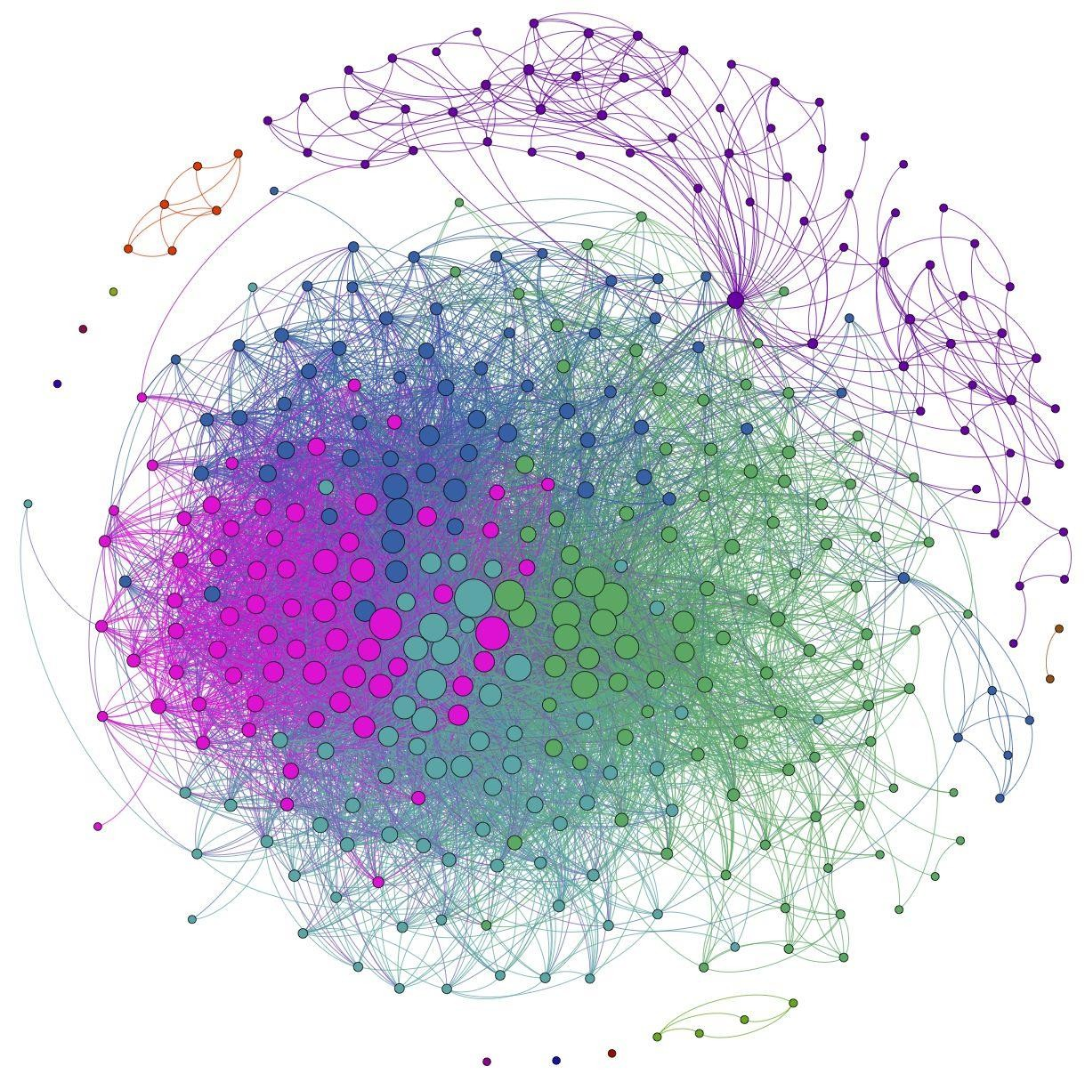
Graph Models
Graph Visualization
Colors
Shapes
Sizes
Nodes organization
Edges thickness
Edge shape
image
38

Slide 17



More Terminology
Walk: Is a sequence of vertices that are connected by edges
Path: A walk is a path iff all 𝑣_{𝑖} are different
If 𝑖 ≠ 𝑗, then 𝑣_{𝑖} ≠ 𝑣_{𝑗}
2
4
1
6
7
8
5
3

Slide 18
More Terminology
Walk: Is a sequence of vertices that are connected by edges
Path: A walk is a path iff all 𝑣_{𝑖} are different
Closed Walk: A walk that begins and ends at the same vertex
2
4
1
6
7
8
5
3

Slide 19
More Terminology
Walk: Is a sequence of vertices that are connected by edges
Path: A walk is a path iff all 𝑣_{𝑖} are different
Closed Walk: A walk that begins and ends at the same vertex
Cycle (Simple Graph): Closed walk of length three or more
2
4
1
6
7
8
5
3

Slide 20
More Terminology
Cycle (digraph):
Closed walk of length 2 or more whose vertices are distinct except for the
beginning and end vertices.
𝑣₂
𝑣₄
𝑣₁
𝑣₆
𝑣
7
𝑣₈
𝑣₃
𝑣₅
46

Slide 21
Trees
Tree: A connected acyclic graph.
Cycle

Slide 22
Trees
Tree: A connected acyclic graph.
Leaf: Is a node with degree 1 in the tree.

Slide 23
Trees
Tree: A connected acyclic graph.
Leaf: Is a node with degree 1 in the tree.
What kind of structure a connected subset of a tree has?
Any connected subgraph of a tree is a tree.

Slide 24
Directed Acyclic Graph (DAG)
A directed acyclic graph (DAG) is a directed graph with no cycles.
53

Slide 25
Directed Acyclic Graph (DAG)
A directed acyclic graph (DAG) is a directed graph with no cycles.
Applications:
Biology:
  Evolution
  Family trees
  Epidemiology
Sociology:
  Citation networks
Computation:
  Scheduling
  Data processing networks
  Causal structures (Bayesian network)
  Version history
Data compression
54

Slide 26
Directed Acyclic Graph (DAG): Examples
A directed acyclic graph (DAG) is a directed graph with no cycles.
Example CS prerequisites:
CSC
452
CSC 230
CSC 350
MAT
191
CSC 340
CSC
261
CSC
362
CSC 462
CSC 130
CSC 339
CSC 250
CSC 330
CSC
471
55

